Slide 1
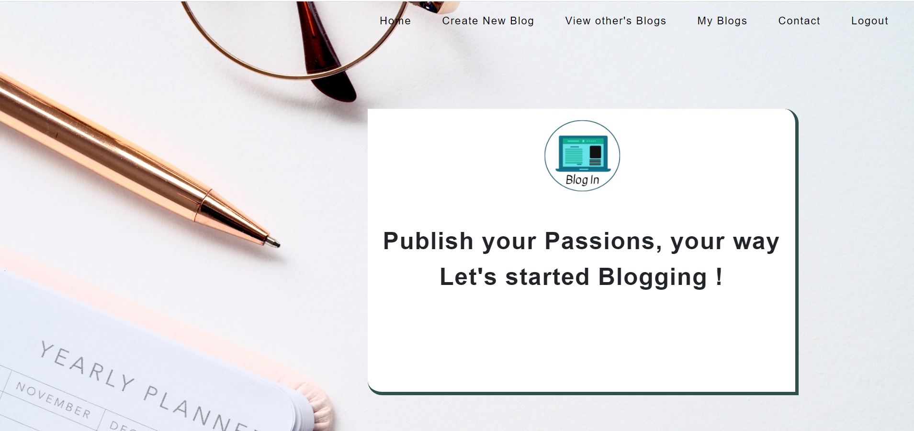
Blog In
Database Management Project for creating and sharing Blogs

Slide 2
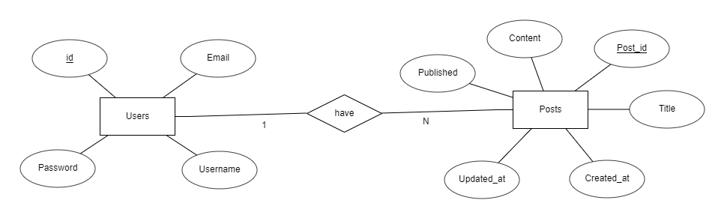
ER Diagram for Blog In

Slide 3
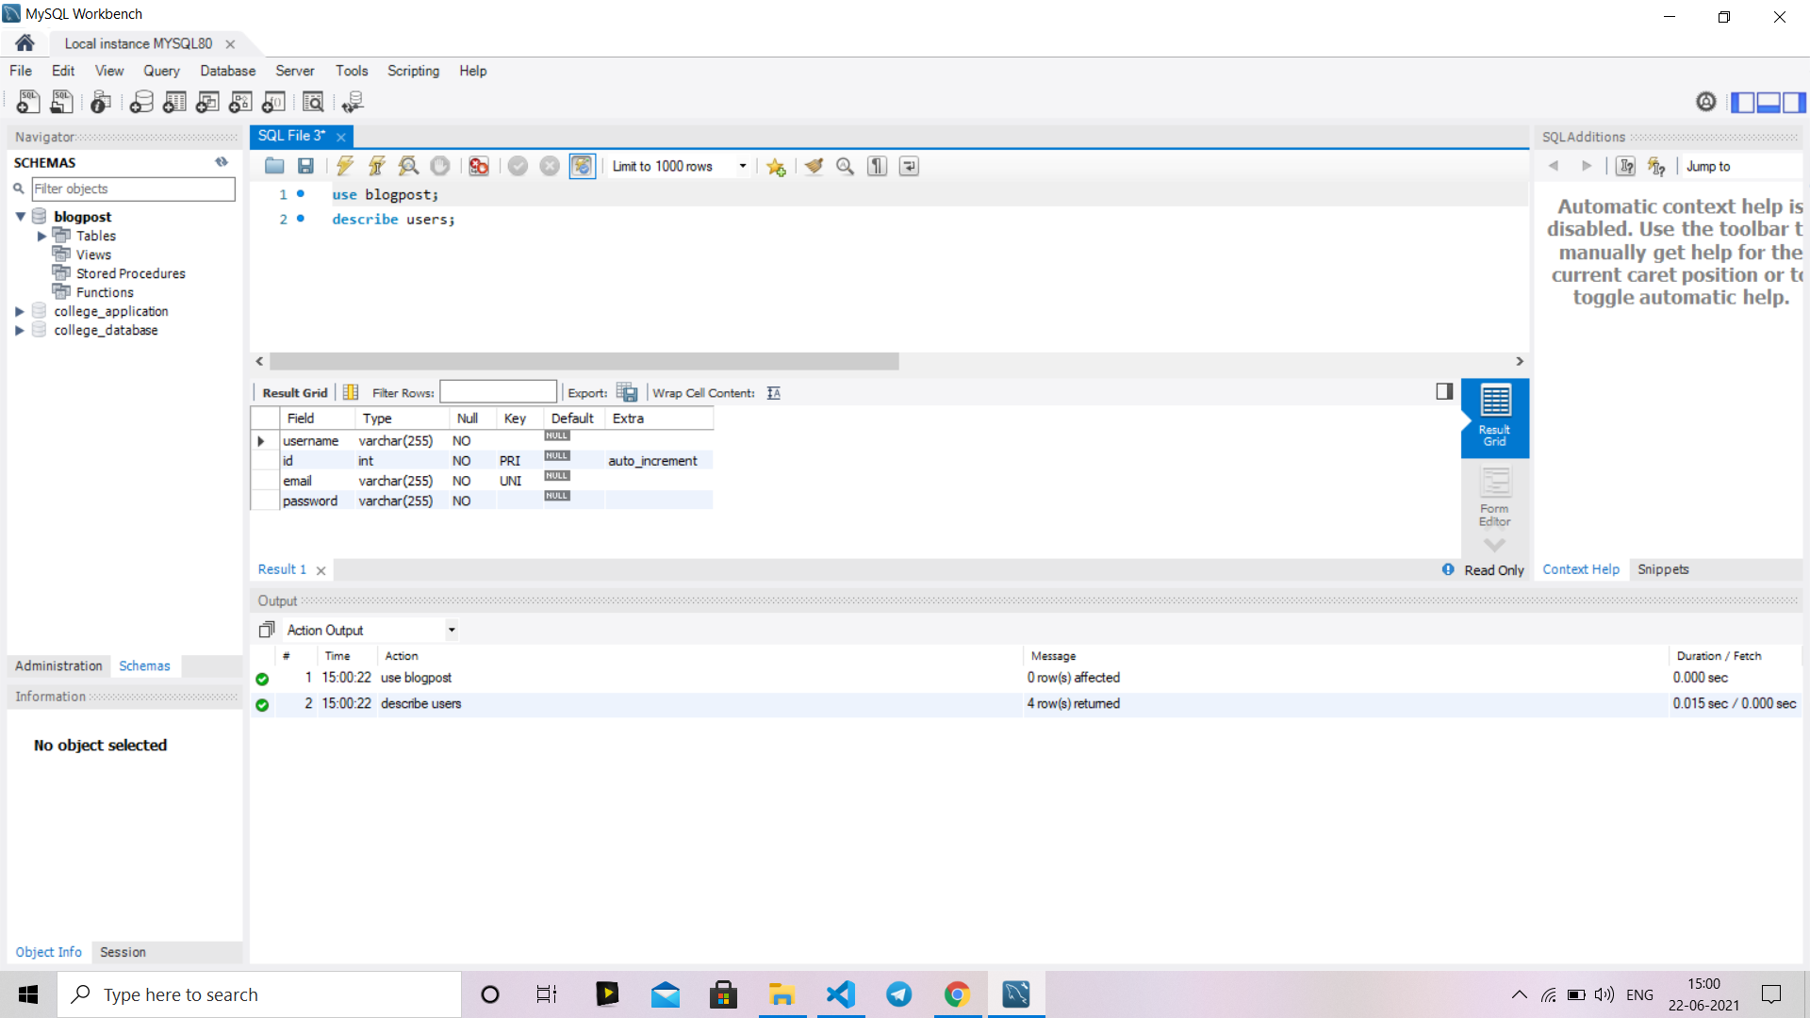
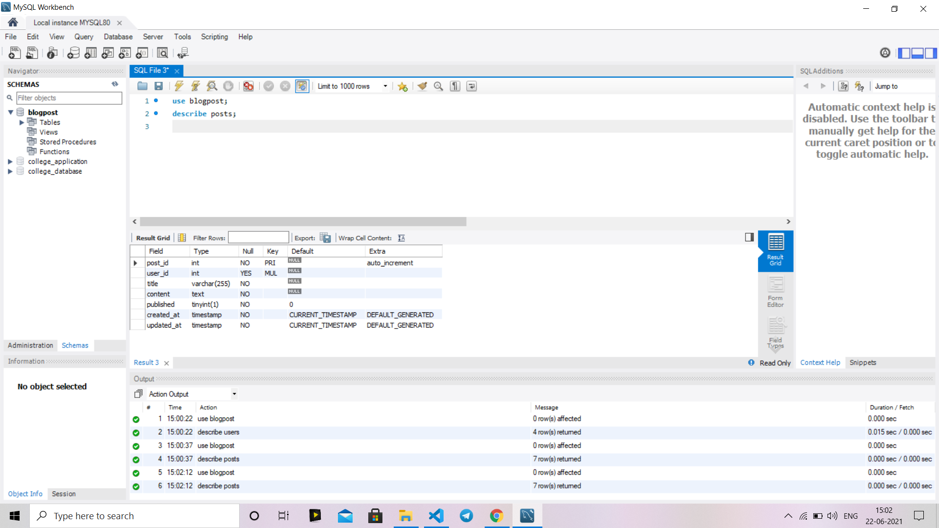
users
Relational Schema
posts
FOREIGN KEY posts (user_id)
REFERENCES users (id)

Slide 4
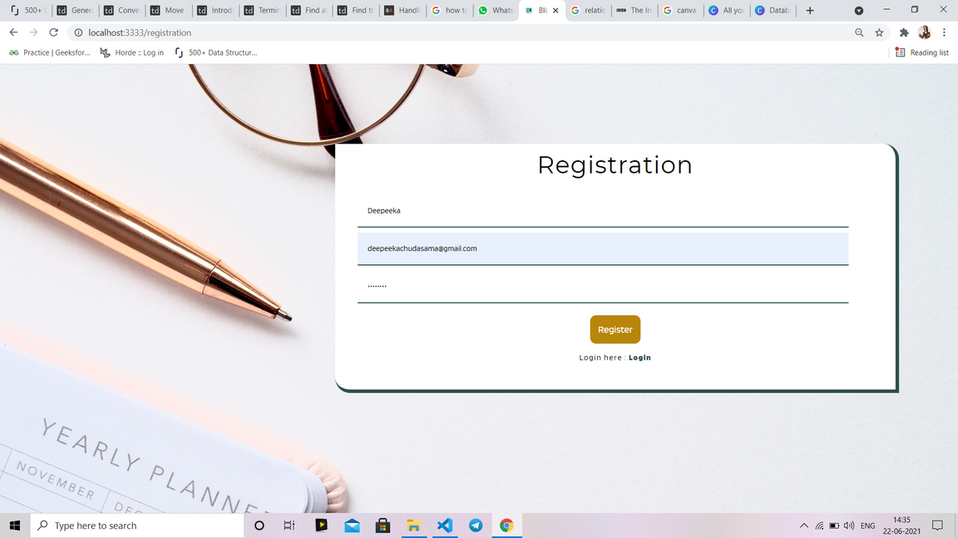
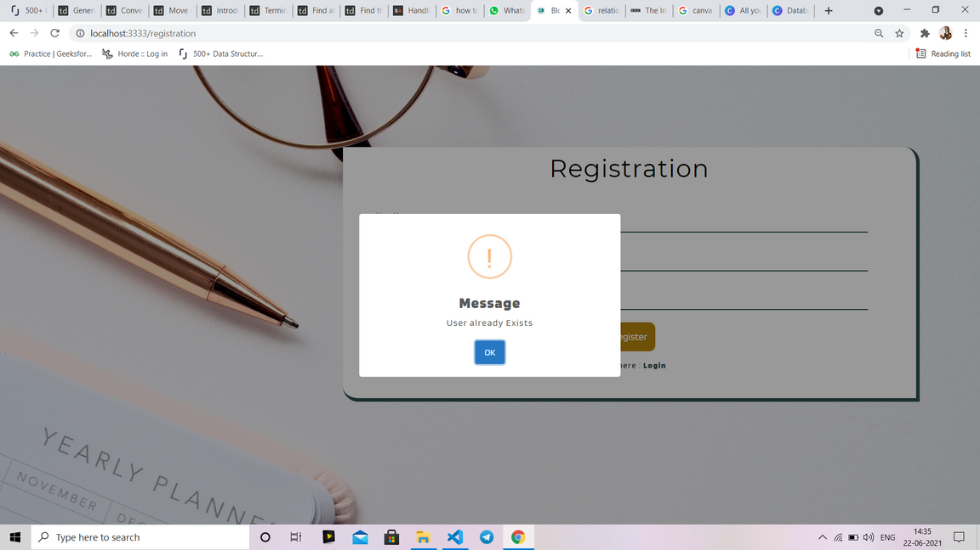
Registration
User can register themselves
(only once)
iew Other's Blogs
If User try to register with same Email ID again,
then they will get an Error message
"Already Exists"

Slide 5
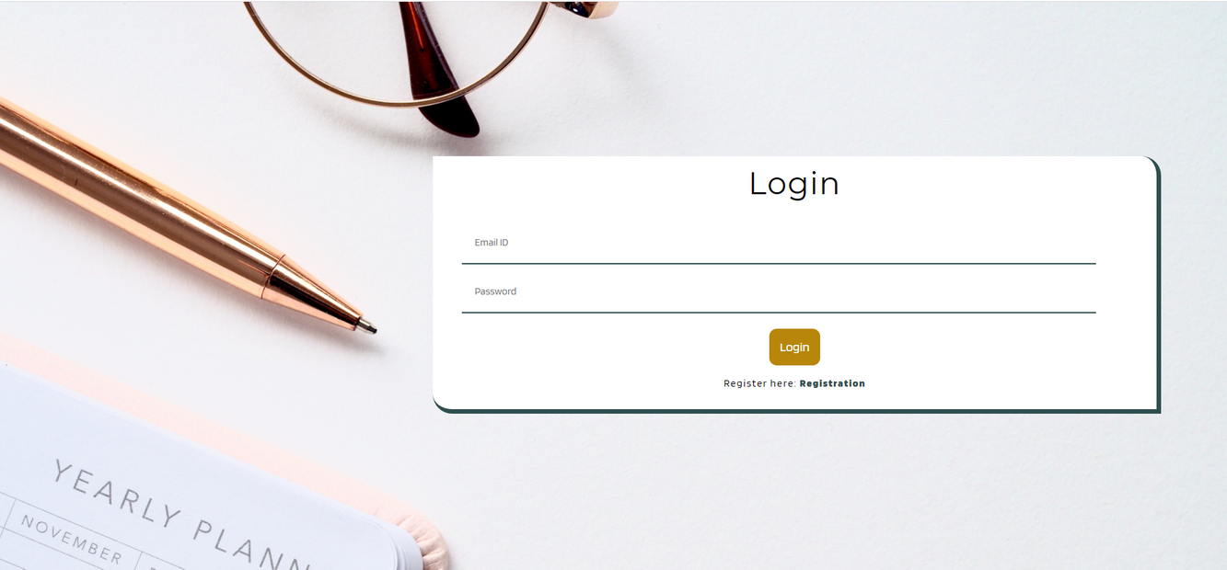
Login
After Login to Blog In, user will be navigating to home page of website, where user can
1) Create New Blog
2) View Other's Blogs
3) View his/her Blogs
Home page

Slide 6
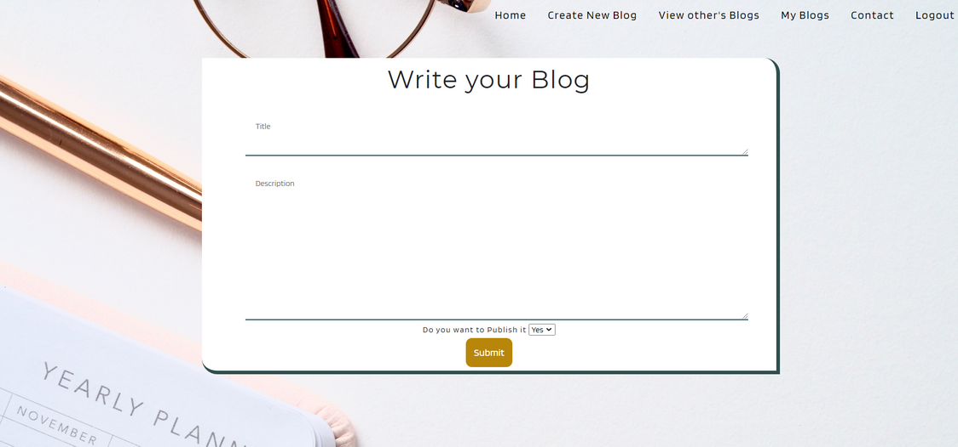
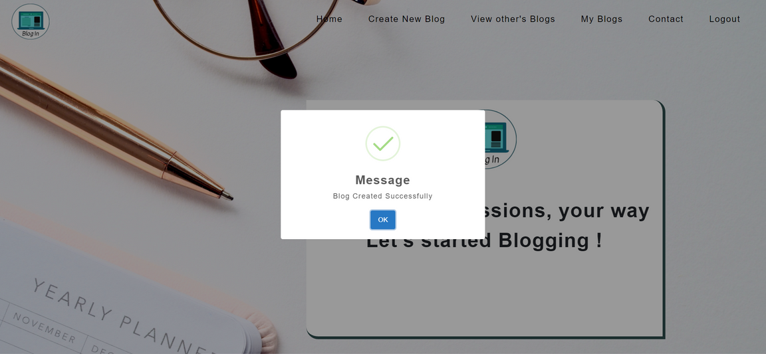
Create New Blog
Here user can create New Blog and also can choose whether they want to publlish the blog, (once published any one can see his/her Blog)
After Successfully Created the blog,
User will get pop up message
"Blog Created Successfully"

Slide 7
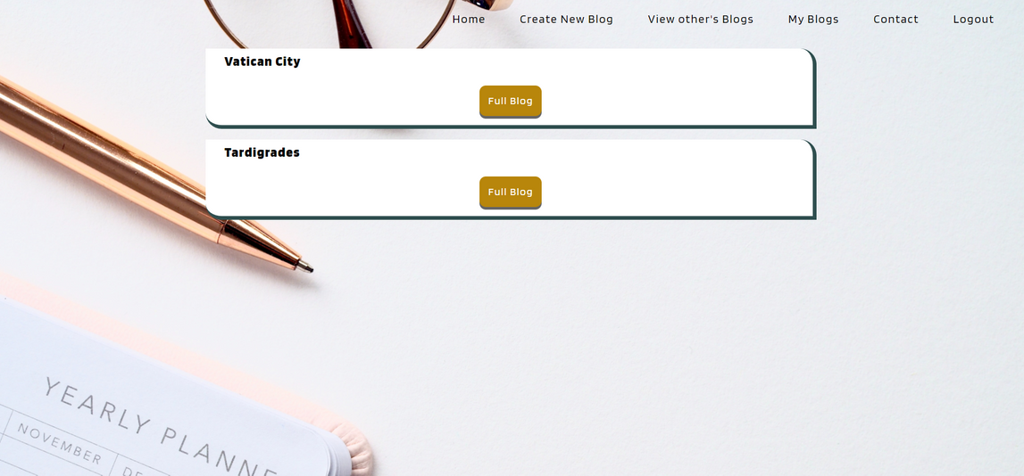
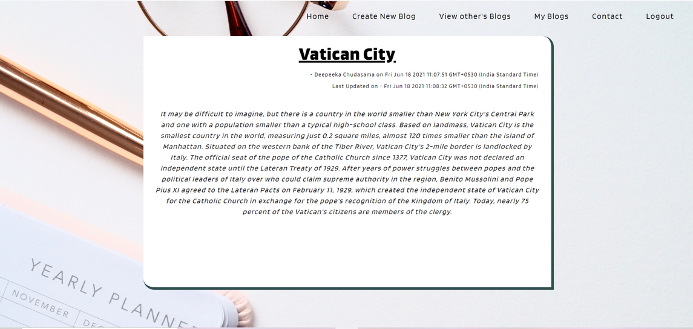
View Other's Blogs
User can view other users Blog as well (but only the published one's)
Full Blog

Slide 8
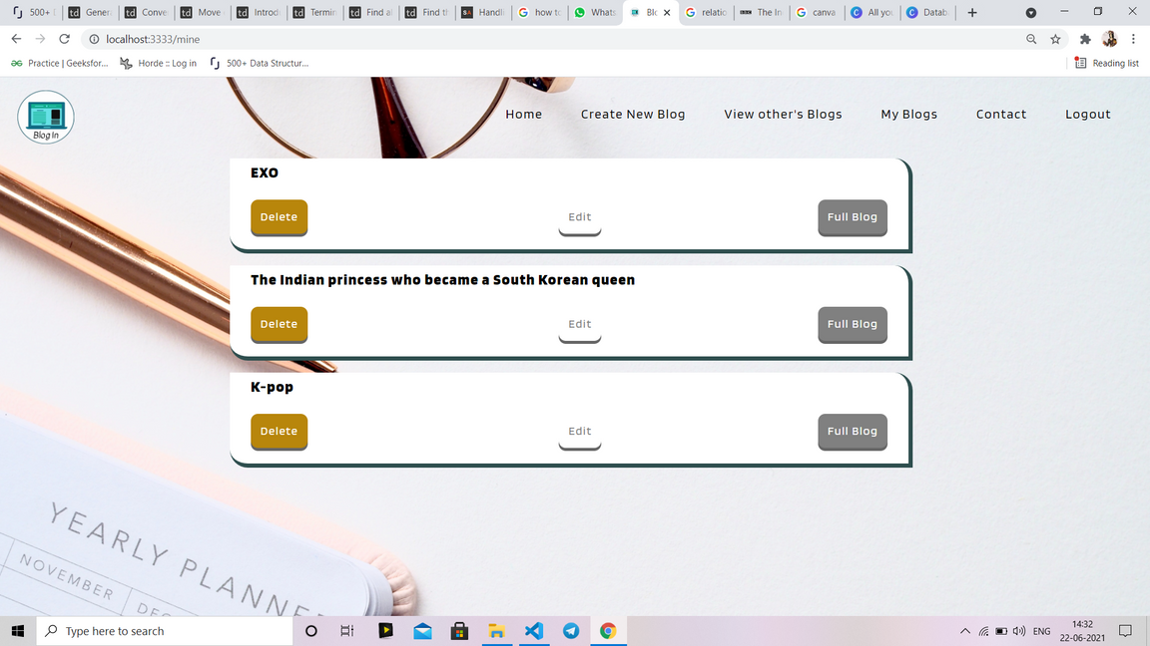
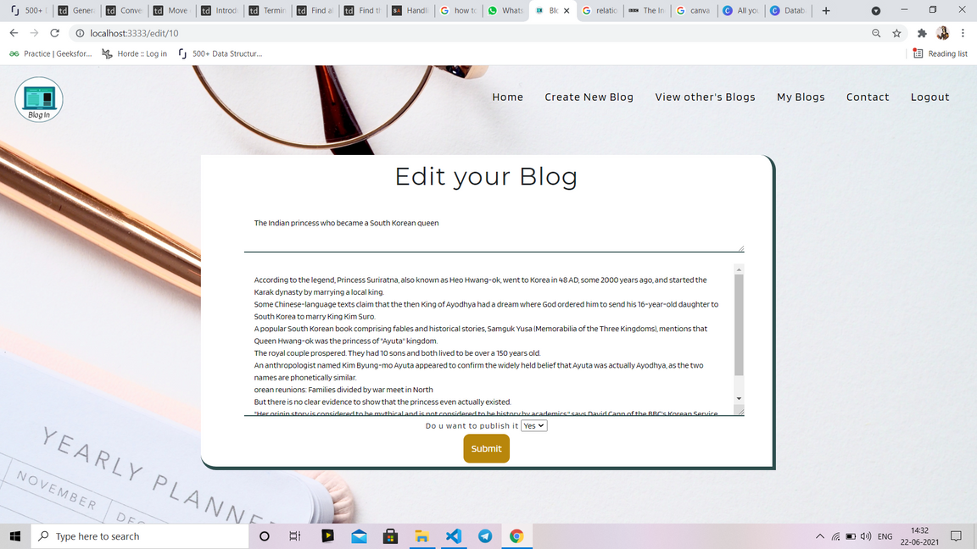
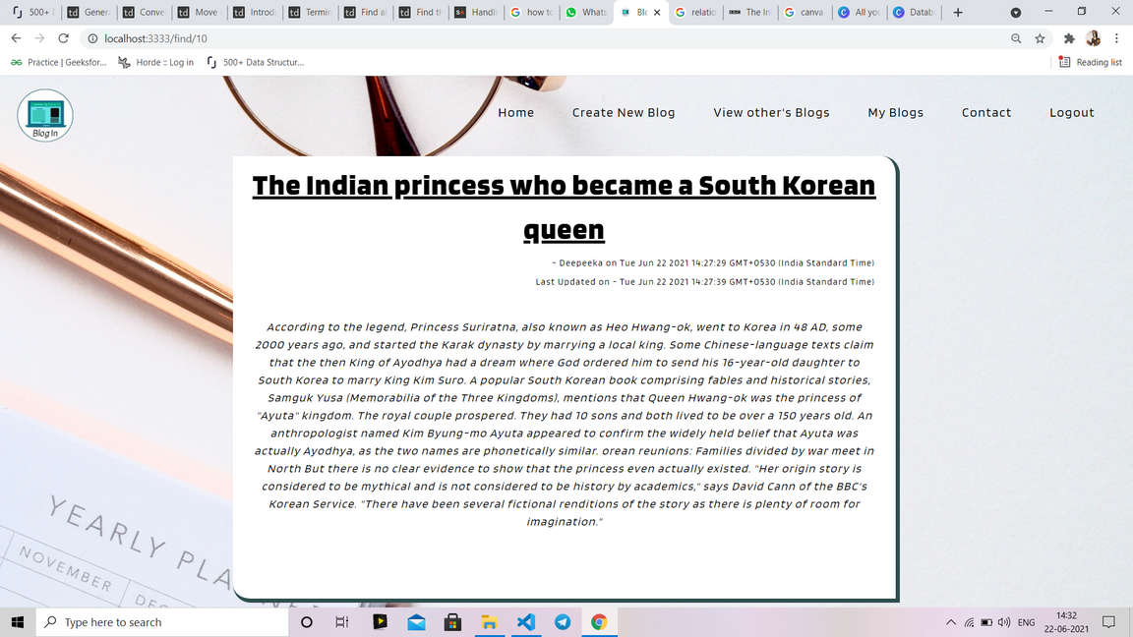
My Blogs
User can view,edit
& delete the Blog
Edit Blog
Full Blog

Slide 9
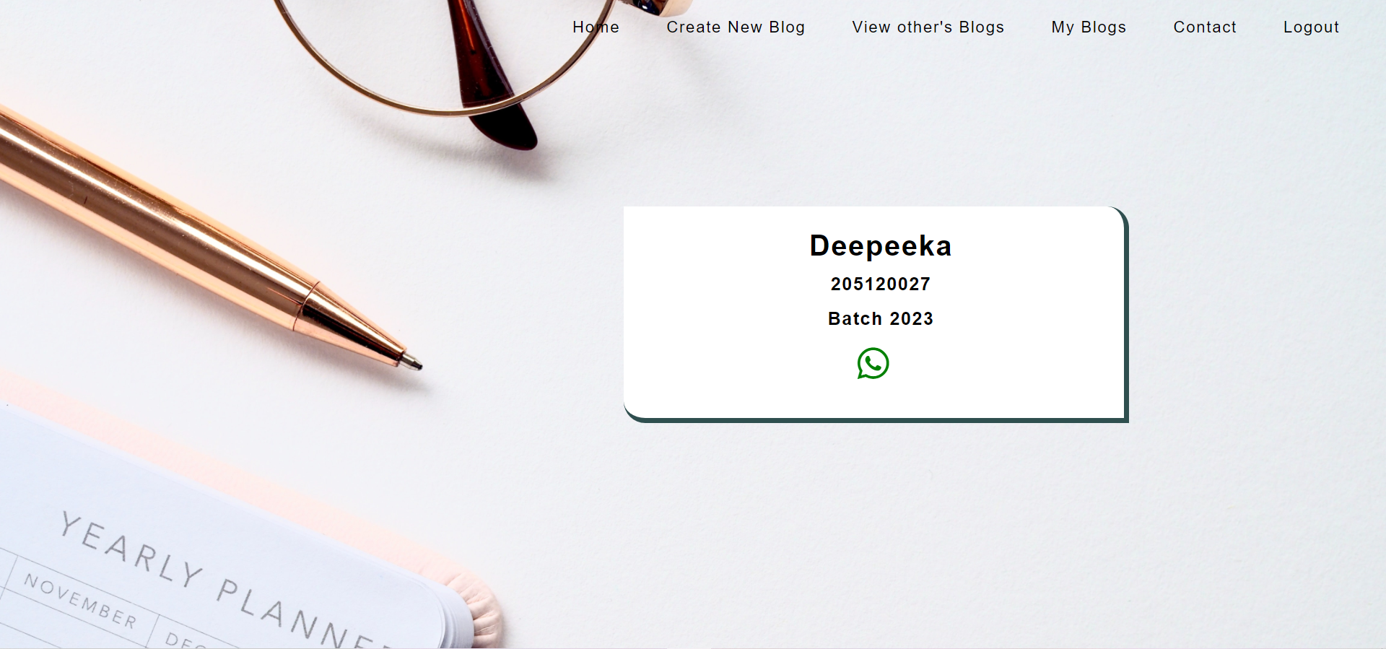
Tech stack used:
Database:Mysql
backend: Node.js and Exoress (Framework)
Frontend: HTML,CSS,js,hbs (Template)

